Slide 1
SQL for Data Analysis

Slide 2
1.Use SELECT, WHERE, ORDER BY, GROUP BY
SELECT Warehouse_block, AVG (Discount_offered) AS avg_discount, COUNT(*) AS total_orders
FROM ecommerce_shipping
WHERE Discount_offered > 10
GROUP BY Warehouse_block
ORDER BY avg_discount DESC
LIMIT 10;

Slide 3
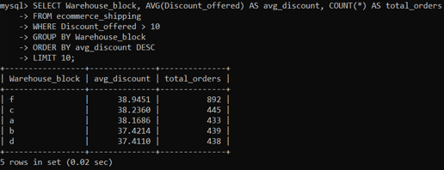

Slide 4
2.Use JOINS (INNER, LEFT, RIGHT)
SELECT a.Warehouse_block, a.Mode_of_Shipment, b.Mode_of_Shipment AS other_mode
FROM ecommerce_shipping a
INNER JOIN ecommerce_shipping b
ON a.Warehouse_block = b.Warehouse_block
AND a.Mode_of_Shipment <> b.Mode_of_Shipment
LIMIT 10;
SELECT a.Warehouse_block, a.Mode_of_Shipment, b.Class
FROM ecommerce_shipping a
LEFT JOIN ecommerce_shipping b
ON a.Warehouse_block = b.Warehouse_block
AND b.Class = 1
LIMIT 10;

Slide 5
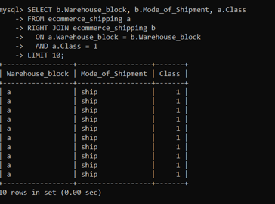
SELECT b.Warehouse_block, b.Mode_of_Shipment, a.Class
FROM ecommerce_shipping a
RIGHT JOIN ecommerce_shipping b
ON a.Warehouse_block = b.Warehouse_block
AND a.Class = 1
LIMIT 10;

Slide 6
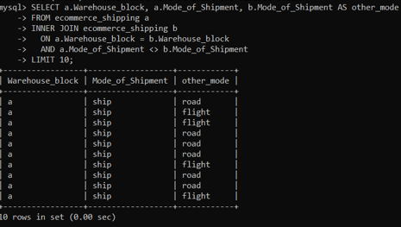
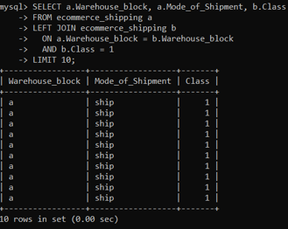

Slide 7
3.Write subqueries
SELECT *
FROM ecommerce_shipping
WHERE Weight_in_gms > (
SELECT AVG(Weight_in_gms) FROM ecommerce_shipping
)
LIMIT 10;

Slide 8
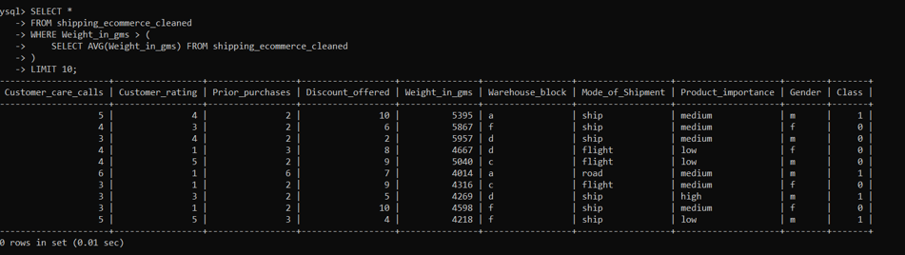

Slide 9
4.Use aggregate functions (SUM, AVG)
SELECT Mode_of_Shipment, SUM(Discount_offered) AS total_discount, AVG(Weight_in_gms) AS avg_weight
FROM ecommerce_shipping
GROUP BY Mode_of_Shipment
LIMIT 10;

Slide 10
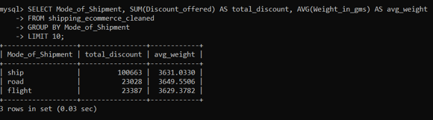

Slide 11
5.Create views for analysis
CREATE VIEW shipment_analysis AS
SELECT Product_importance, Mode_of_Shipment,
AVG(Customer_rating) AS avg_rating,
SUM(Discount_offered) AS total_discount
FROM ecommerce_shipping
GROUP BY Product_importance, Mode_of_Shipment;

Slide 12
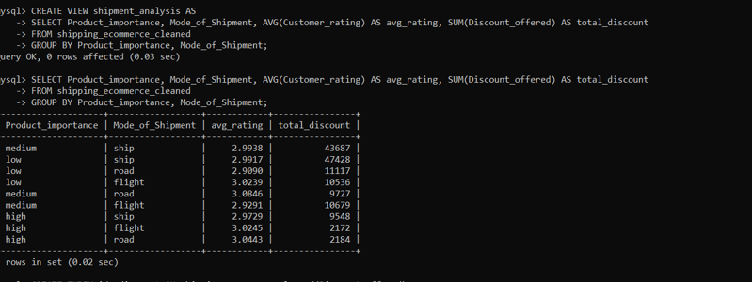

Slide 13
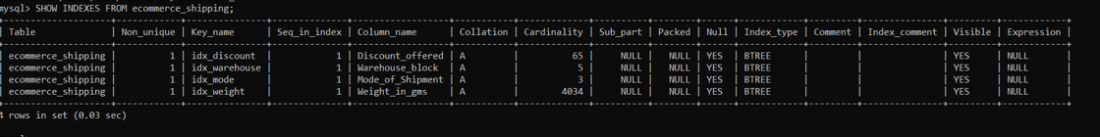
6.Optimize queries with indexes
CREATE INDEX idx_discount ON ecommerce_shipping(Discount_offered);
CREATE INDEX idx_weight ON ecommerce_shipping(Weight_in_gms);
CREATE INDEX idx_mode ON ecommerce_shipping(Mode_of_Shipment);

Slide 14




